Slide 1
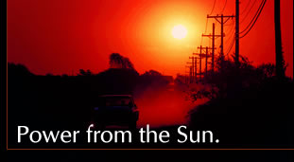
Solar Energy:
The Ultimate Renewable Resource
Bhavik Shah

Slide 2
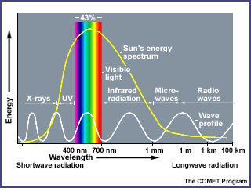
What is Solar Energy?
Originates with the thermonuclear fusion reactions occurring in the sun.
Represents the entire electromagnetic radiation (visible light, infrared, ultraviolet, x-rays, and radio waves).

Slide 3
Advantages and Disadvantages
Advantages
    All chemical and radioactive polluting byproducts of the thermonuclear reactions remain behind on the sun, while only pure radiant energy reaches the Earth.
    Energy reaching the earth is incredible. By one calculation, 30 days of sunshine striking the Earth have the energy equivalent of the total of all the planet’s fossil fuels, both used and unused!
Disadvantages
    Sun does not shine consistently.
    Solar energy is a diffuse source. To harness it, we must concentrate it into an amount and form that we can use, such as heat and electricity.
    Addressed by approaching the problem through:
    1) collection, 2) conversion, 3) storage.

Slide 4
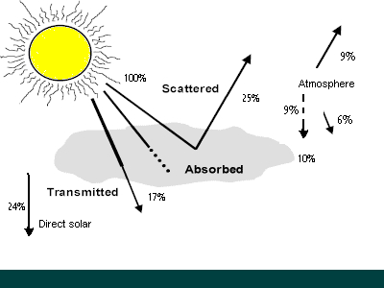
How much solar energy?
The surface receives about 47% of the total solar energy that reaches the Earth. Only this amount is usable.

Slide 5
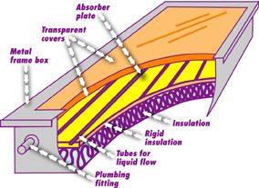
Putting Solar Energy to Use: Heating Water
Two methods of heating water: passive (no moving parts) and active (pumps).
In both, a flat-plate collector is used to absorb the sun’s energy to heat the water.
The water circulates throughout the closed system due to convection currents.
Tanks of hot water are used as storage.

Slide 6
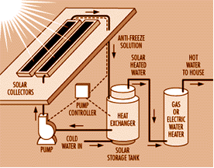
Heating Water: Active System
Active System uses antifreeze so that the liquid does not freeze if outside temp. drops below freezing.

Slide 7
Heating Water—Last Thoughts
Efficiency of solar heating system is always less than 100% because:
        % transmitted depends on angle of incidence,
        Number of glass sheets (single glass sheet transmits 90-95%), and
        Composition of the glass
Solar water heating saves approx. 1000 megawatts of energy a yr, equivalent to eliminating the emissions from two medium sized coal burning power plants.
By using solar water heating over gas water heater, a family will save 1200 pounds of pollution each year.
Market for flat plate collectors grew in 1980s because of increasing fossil fuels prices and federal tax credits. But by 1985, when these credits were removed and fossil fuel prices were low, the demand for flat plate collectors shrunk quickly.
While solar water heating is relatively low in the US, in other parts of the world such as Cyprus (90%) and Israel (65%), it proves to be the predominate form of water heating.

Slide 8
Heating Living Spaces
Best design of a building is for it to act as a solar collector and storage unit. This is achieved through three elements: insulation, collection, and storage.
Efficient heating starts with proper insulation on external walls, roof, and the floors. The doors, windows, and vents must be designed to minimize heat loss.
Collection: south-facing windows and appropriate landscaping.
Storage: Thermal mass—holds heat.
    Water= 62 BTU per cubic foot per degree F.
    Iron=54, Wood (oak) =29, Brick=25, concrete=22, and loose stone=20

Slide 9
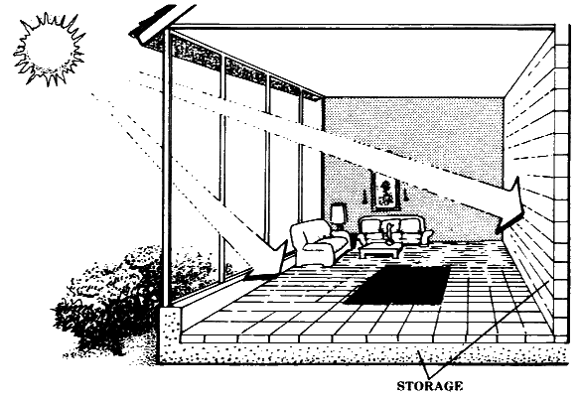
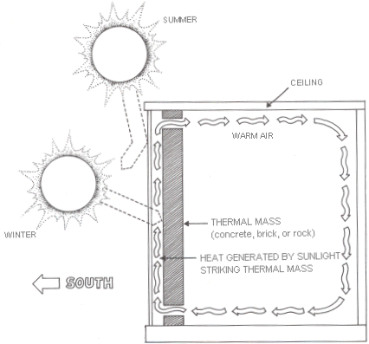
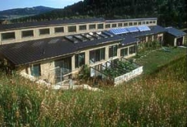
Heating Living Spaces
Passive Solar
Trombe Wall
Passively heated home in Colorado

Slide 10
Heating Living Spaces
A passively heated home uses about 60-75% of the solar energy that hits its walls and windows.
The Center for Renewable Resources estimates that in almost any climate, a well-designed passive solar home can reduce energy bills by 75% with an added construction cost of only 5-10%.
About 25% of energy is used for water and space heating.
Major factor discouraging solar heating is low energy prices.

Slide 11
Solar-Thermal Electricity:
Power Towers
General idea is to collect the light from many reflectors spread over a large area at one central point to achieve high temperature.
Example is the 10-MW solar power plant in Barstow, CA.
    1900 heliostats, each 20 ft by 20 ft
    a central 295 ft tower
An energy storage system allows it to generate 7 MW of electric power without sunlight.
Capital cost is greater than coal fired power plant, despite the no cost for fuel, ash disposal, and stack emissions.
Capital costs are expected to decline as more and more power towers are built with greater technological advances.
One way to reduce cost is to use the waste steam from the turbine for space heating or other industrial processes.

Slide 12
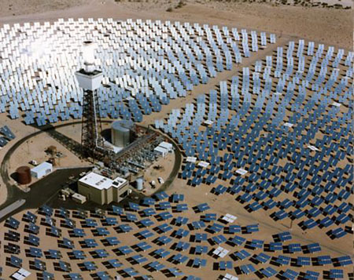
Power Towers
Power tower in Barstow, California.

Slide 13
Solar-Thermal Electricity:
Parabolic Dishes and Troughs
Focus sunlight on a smaller receiver for each device; the heated liquid drives a steam engine to generate electricity.
The first of these Solar Electric Generating Stations (SEGS) was installed in CA by an Israeli company, Luz International.
Output was 13.8 MW; cost was $6,000/peak kW and overall efficiency was 25%.
Through federal and state tax credits, Luz was able to build more SEGS, and improved reduced costs to $3,000/peak kW and the cost of electricity from 25 cents to 8 cents per kWh, barely more than the cost of nuclear or coal-fired facilities.
The more recent facilities converted a remarkable 22% of sunlight into electricity.

Slide 14
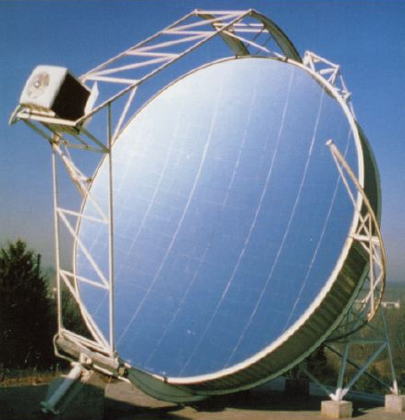
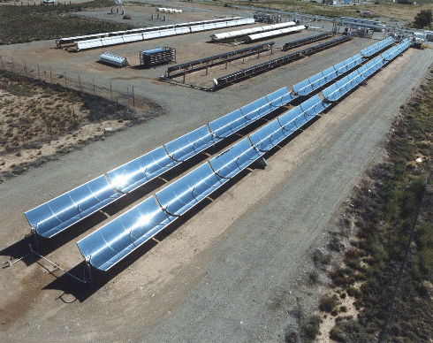
Parabolic Dishes and Troughs
Collectors in southern CA.
Because they work best under direct sunlight, parabolic dishes and troughs must be steered throughout the day in the direction of the sun.

Slide 15
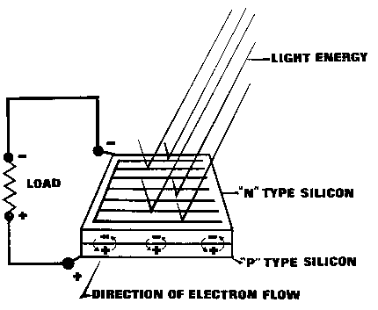
Direct Conversion into Electricity
Photovoltaic cells are capable of directly converting sunlight into electricity.
A simple wafer of silicon with wires attached to the layers. Current is produced based on types of silicon (n- and p-types) used for the layers. Each cell=0.5 volts.
Battery needed as storage
No moving parts→do no wear out, but because they are exposed to the weather, their lifespan is about 20 years.

Slide 16
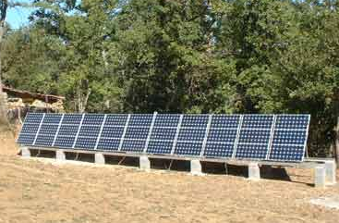
Solar Panels in Use
Because of their current costs, only rural and other customers far away from power lines use solar panels because it is more cost effective than extending power lines.
Note that utility companies are already purchasing, installing, and maintaining PV-home systems (Idaho Power Co.).
Largest solar plant in US, sponsored by the DOE, served the Sacramento area, producing 2195 MWh of electric energy, making it cost competitive with fossil fuel plants.

Slide 17
Efficiency and Disadvantages
Efficiency is far lass than the 77% of solar spectrum with usable wavelengths.
43% of photon energy is used to warm the crystal.
Efficiency drops as temperature increases (from 24% at 0°C to 14% at 100°C.)
Light is reflected off the front face and internal electrical resistance are other factors.
Overall, the efficiency is about 10-14%.
Cost of electricity from coal-burning plants is anywhere b/w 8-20 cents/kWh, while photovoltaic power generation is anywhere b/w $0.50-1/kWh.
Does not reflect the true costs of burning coal and its emissions to the nonpolluting method of the latter.
Underlying problem is weighing efficiency against cost.
  Crystalline silicon-more efficient, more expensive to manufacture
  Amorphous silicon-half as efficient, less expensive to produce.

Slide 18
Final Thought
Argument that sun provides power only during the day is countered by the fact that 70% of energy demand is during daytime hours. At night, traditional methods can be used to generate the electricity.
Goal is to decrease our dependence on fossil fuels.
Currently, 75% of our electrical power is generated by coal-burning and nuclear power plants.
Mitigates the effects of acid rain, carbon dioxide, and other impacts of burning coal and counters risks associated with nuclear energy.
pollution free, indefinitely sustainable.

Slide 19
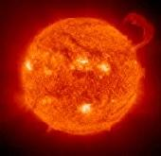
The End

